Slide 1
HNDIT2417
Mobile Application Development
Layouts

Slide 2
Layout
Basic building block in an app.
A layout defines the visual structure of arranging components for a user interface.
Layouts are usually defined using XML

Slide 3
Layouts
Frame layout
Linear Layout
  Horizontal
  Vertical
Table layout
Grid Layout
Relative layout

Slide 4
Linear Layout
view group that aligns all children in linearly either vertically or horizontally
  Horizontal
    Aligns all the views it contains horizontally
  Vertical
    Aligns all the views it contains vertically

Slide 5

Linear Layout - Horizontal Orientation
One row, many columns
Items placed beside each other
<LinearLayout xmlns:android=http://schemas.android.com/apk/res/android
.
.
android:orientation="horizontal"
/>

Slide 6

Linear Layout - Vertical Orientation
One column, many rows
Items stacked on top of each other
<LinearLayout xmlns:android=http://schemas.android.com/apk/res/android
.
.
android:orientation=“vertical"
/>

Slide 7
Gravity
Gravity provides the placing of an object within a larger container.
Two types of Gravity in Android
  gravity
  layout_gravity

Slide 8
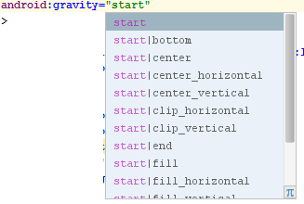
android:gravity
Specifies how an object should position its content
Has several values:
  top
  bottom
  left
  right
  center (horizontal and vertical)
  center_vertical
  center_horizontal

Slide 9
android:layout_gravity
Positions the view with respect to its parent
Supports same values as android:gravity
Not all ViewGroups support this attribute.

Slide 10
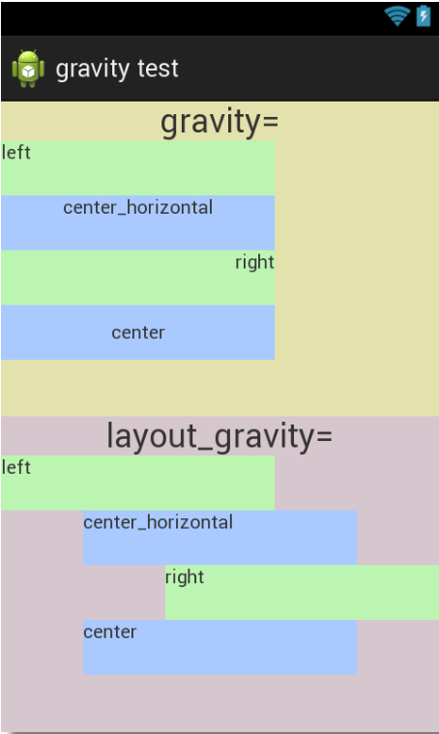
gravity vs. layout_gravity
gravity
  Arranges the content inside
  the view.
layout_gravity
  Arranges the view's
  position outside of itself.

Slide 11
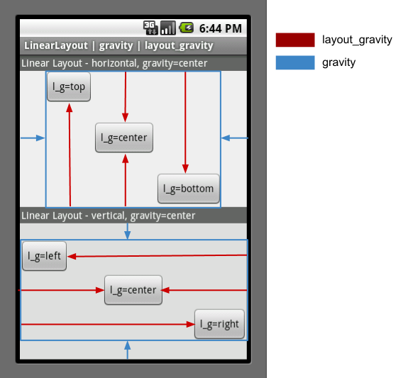
layout_gravity & gravity Example

Slide 12
Layout Width and Height
wrap_content : Wrap the layout to its content
match_parent :Set to its parents size
dp : Specify in density independent pixels

Slide 13
layout_weight
Attribute only works for LinearLayout
Indicates how much of the extra space in the LinearLayout will be allocated to the child view associated with this attribute.

Slide 14
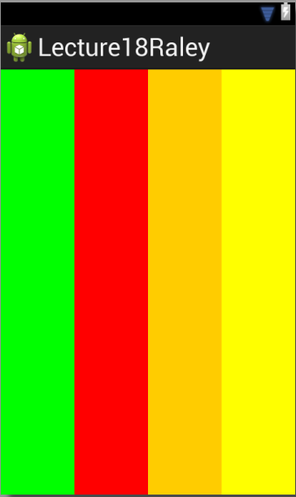
layout_weight to the rescue
<?xml version="1.0" encoding="utf-8"?>
<LinearLayout xmlns:android="http://schemas.android.com/apk/res/android"
android:id="@+id/pink"
android:layout_width="match_parent"
android:layout_height="match_parent"
android:orientation="horizontal"
android:background="#00F" >
<View
android:layout_width="0dp"
android:layout_height="match_parent"
android:layout_weight=".25"
android:background="#0F0"/>
<View
android:layout_width="0dp"
android:layout_height="match_parent"
android:layout_weight=".25"
android:background="#F00"/>
<View
android:layout_width="0dp"
android:layout_height="match_parent"
android:layout_weight=".25"
android:background="#FC0"/>
<View
android:layout_width="0dp"
android:layout_height="match_parent"
android:layout_weight=".25"
android:background="#FF0"/>
</LinearLayout>

Slide 15

RelativeLayout
RelativeLayout is a view group that displays child views in relative positions.

Slide 16
About RelativeLayout
Unless you specify a vertical position/alignment, a child view will match the top of its parent.
Unless you specify a horizontal position/alignment, a child view will match the left of its parent.

Slide 17
How
layout_alignParentTop
layout_below
layout_alignParentLeft
layout_below
layout_alignParentRight

Slide 18
Layout Editor
Using layout editor user can quickly build layouts by dragging UI elements into a visual design editor instead of writing the layout XML by hand

